Slide 1
TENSES
Past Forms
Prepared by Pavel Zhukovski (13 group)

Slide 2
Past tenses
Past Simple
Past Perfect
Past Continuous
Past Perfect Continuous

Slide 3
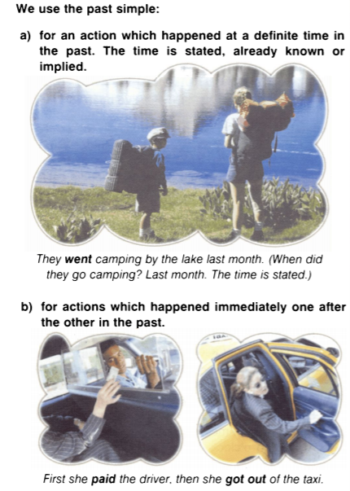
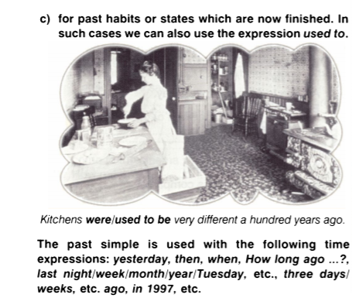
Past simple

Slide 4
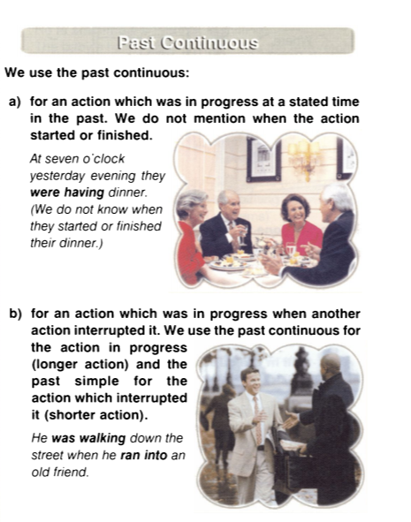
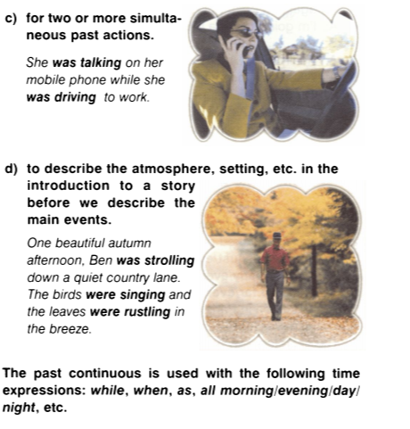
Past continuous

Slide 5
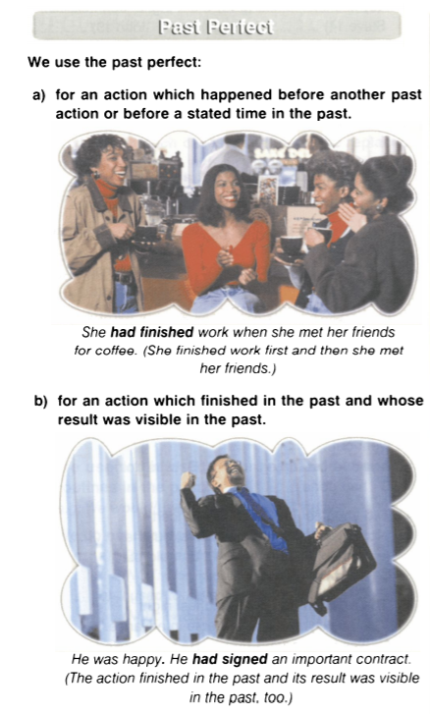
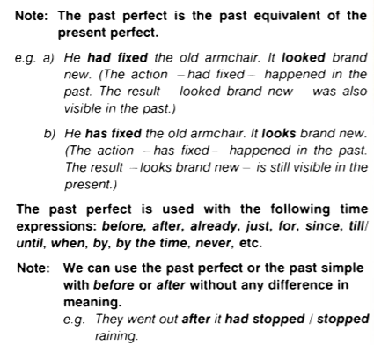
Past perfect

Slide 6
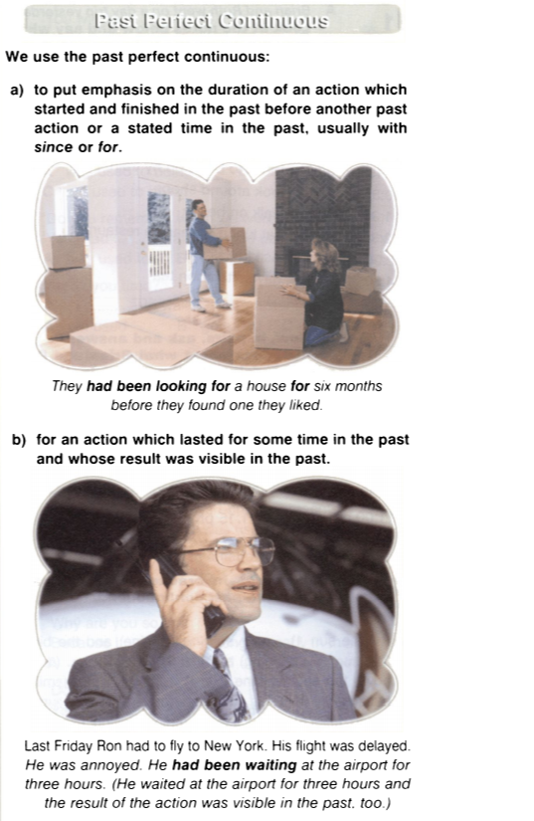
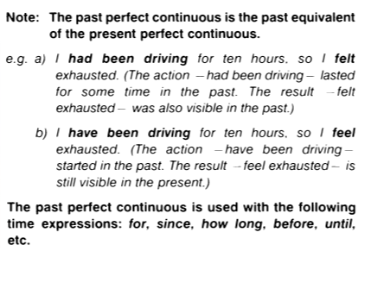
Past perfect continuous

Slide 7
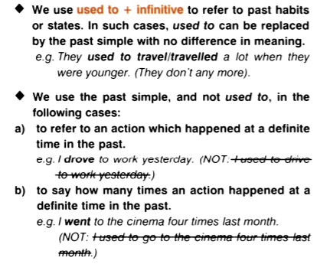
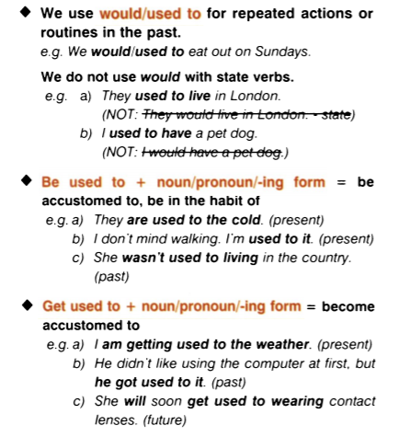
Used to / be used to / get used to / would

Slide 8
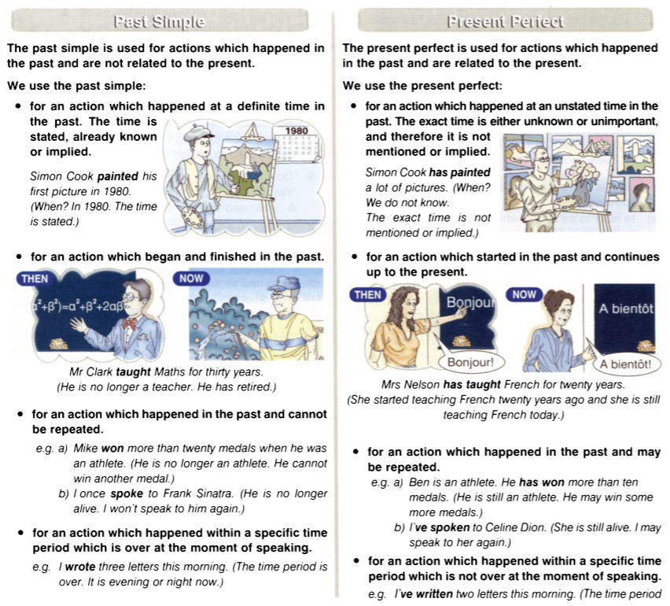
differences
Note: We use the past simple to talk about actions which were performed by people who are no longer alive, even if the time is not stated.
e.g. Charles Dickens wrote ‘Oliver Twist.’

Slide 9
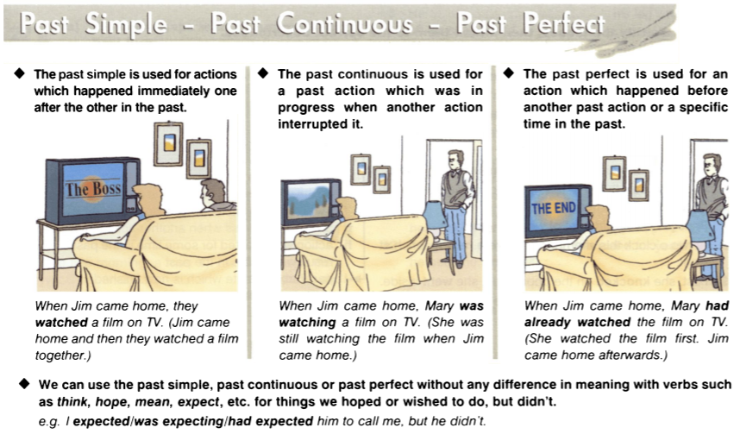
Differences (continuation)

Slide 10
THANKS FOR ATTENTION AND GOOD LUCK!

